Slide 1
A randomized controlled trial of lung ultrasound guided therapy in heart failure (CLUSTER_HF study)
American Heart Journal
15/06/2020

Slide 2
Basics of lung ultrasound
LUS can be performed quickly and easily in critically ill patients
Higher diagnostic accuracy than physical examination and chest radiography combined
Enhances safety by avoiding ionizing radiation

Slide 3
Physics: air, water, and echoes
The appearances of LUS based on the relative amounts of air and fluid in the lung because of the phenomenon of acoustic impedance (Z)
Z - measure of the resistance of particles in a medium to mechanical vibrations
Resistance increases in proportion to the density of the medium and the propagation velocity of US in the medium

Slide 4
When US hits a relatively large and flat boundary between mediums with different impedances, some of the sound is transmitted across the boundary and some is reflected (an echo).
The greater the difference in Z, the greater the reflection
Fluid has a constant Z resulting in no echoes and so appears black
Soft tissues have very similar values of Z resulting in minimal reflection

Slide 5
Interfaces between bone and soft tissue reflect about 40% of US energy
Soft tissue and air reflect 99.9% rendering this interface virtually impenetrable to US
This means structures below the pleura in an air filled lung
cannot be visualized—only artifacts will be seen
LUS relies on the interpretation of artifacts in conditions where the lung is predominantly aerated

Slide 6
Probes
Linear probe (8–12 MHz)
High-frequency probes give good resolution of superficial structures
Excellent images of the pleura and lung sliding can be obtained
Poor penetration of high-frequency US and the narrow sector width mean deeper structures are poorly imaged

Slide 7
Curvilinear probe (3–5 MHz)
Best all-round probe for LUS
Lung sliding and IS easily visualized
Effusions, consolidated lung, and the diaphragm well imaged because of the good penetration and large sector width
Large footprint of the probe means some angulation is needed to avoid the ribs

Slide 8
Phased array (3–4.5 MHz)
These probes have a useful footprint for getting in between the ribs
They can be used to demonstrate all the signs of LUS but the clarity of the images is not as good

Slide 9
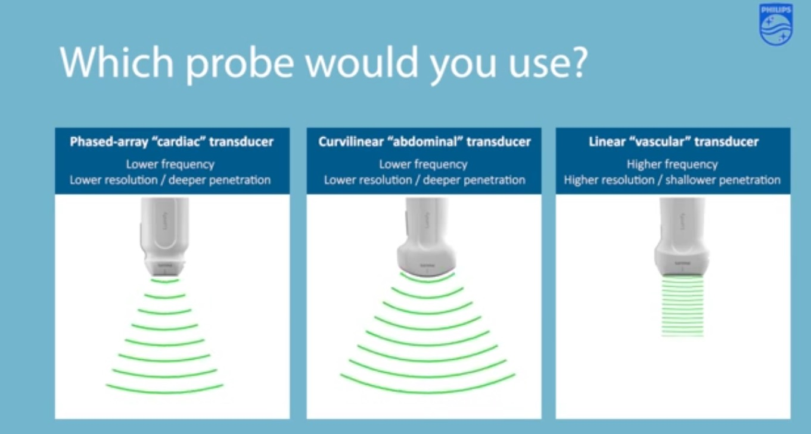

Slide 10
Technique
LUS can be performed on the whole chest, just laying the probe in the intercostal spaces, avoiding the ribs
Probe can be positioned both longitudinally, perpendicular to the ribs, and obliquely, along the intercostal spaces

Slide 11
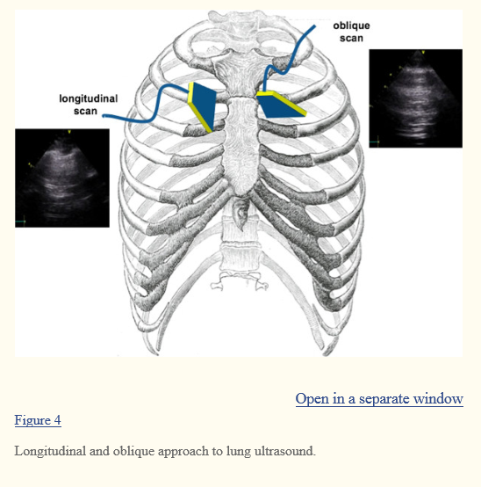

Slide 12
Normal appearance
All signs in LUS arise from the pleural line except for subcutaneous emphysema which will abolish it (as there is air above it)
Rib shadows will be seen (as the sound is reflected back to the probe) and in between them the bright white pleural line about 0.5 cm below the rib line

Slide 13
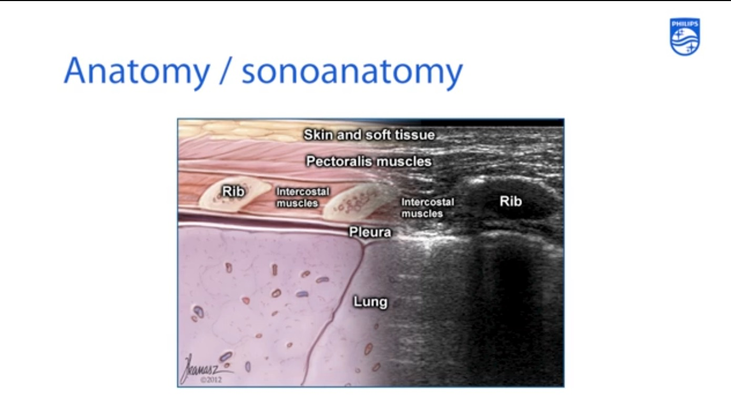

Slide 14
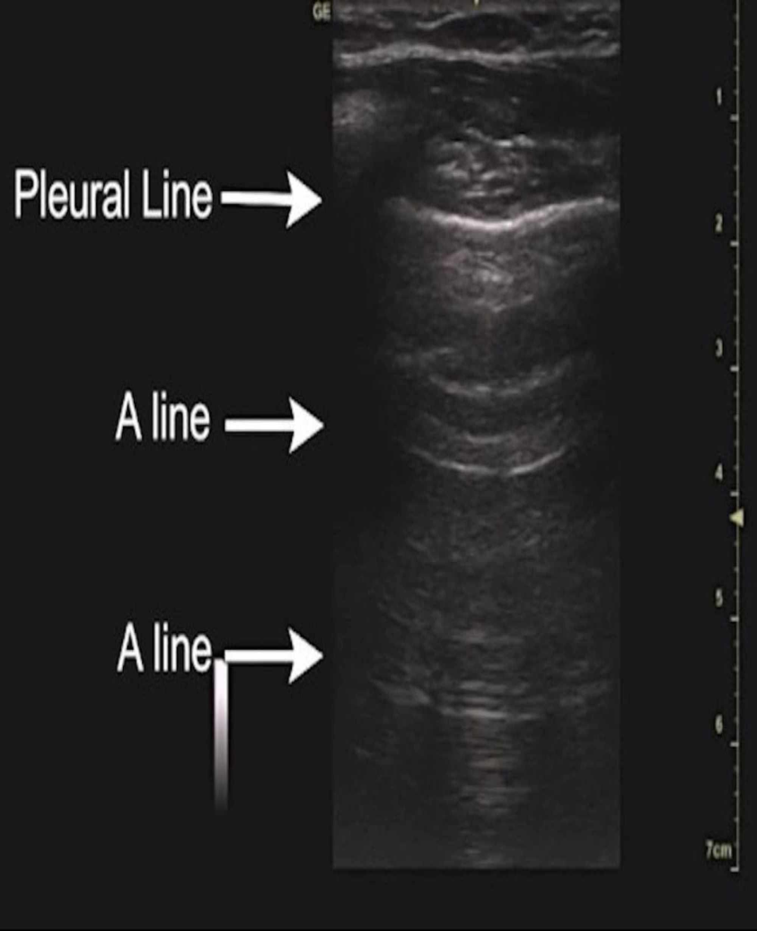
Air below the pleural line reflects most US back to the transducer
This is itself a reflector, meaning some of the US waves will bounce back and forth between the pleura and transducer generating artifacts called A lines
They are horizontal lines below the pleura with the same spacing as the distance between the probe and the pleural line

Slide 15
Lung sliding
The visceral and parietal pleura are normally closely opposed with a minute amount of fluid between them and slide over one another with respiration
The appearance of this is backwards and forwards movement of the pleura (often with little blebs appearing to move up and down the pleural line)
Small artifacts (white or black lines) projecting a few mm below the pleural line move with sliding
More commonly seen with high-frequency probes and have no clinical significance

Slide 16
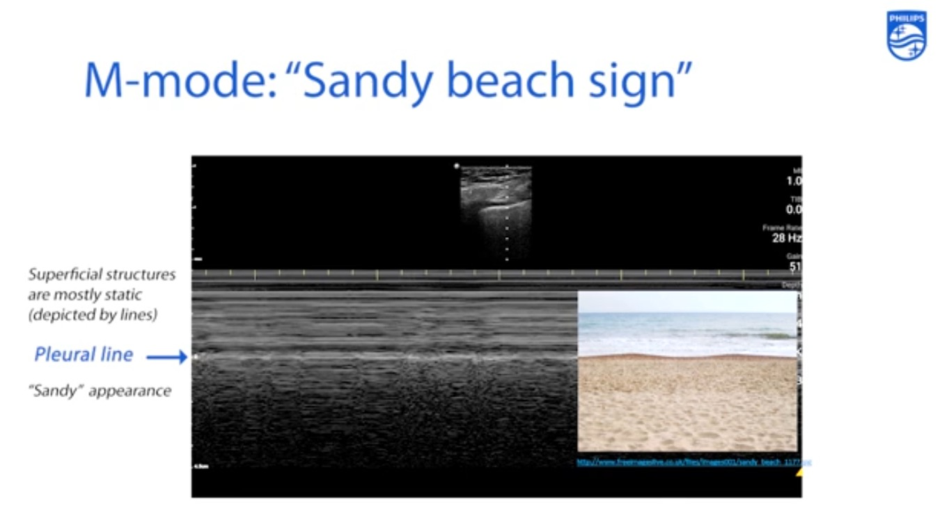

Slide 17
Interstitial syndrome
IS is a sonographic entity caused by
• Pulmonary edema—either hemodynamic (fluid overload, cardiac failure) or permeability-induced (ALI/ARDS)
• Interstitial pneumonia or pneumonitis
• Lung fibrosis

Slide 18
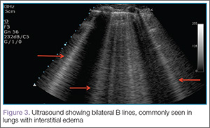
The US feature of IS is B lines
Artifacts generated by the juxtaposition of alveolar air and septal thickening
Their characteristics are
• They arise from the pleural line
• They are long, vertical hyperechoic lines which continue to the depths of the image
• They look like comet tails
• They erase A lines.
• They move with lung sliding

Slide 19
Up to two between two adjacent ribs can be considered normal
Three or more between rib spaces (or close together in a transverse image) are pathological
Present in any disease affecting the interstitium
Commonest cause is pulmonary edema where they
are the equivalent of Kerley B lines

Slide 20
Alveolar syndrome
The sonographic entity of alveolar syndrome encompasses alveolar consolidation and atelectasis

Slide 21
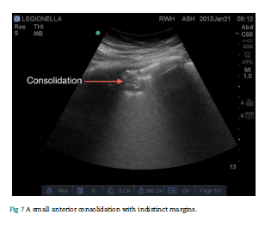
Consolidation
Consolidations are highly fluid filled, and over 95% reach the pleura so US can image the pathology directly
Anterior consolidations
Usually small echo poor areas beneath the pleura
Peri-lesional B lines and comets deep to the far margins are common.
Margins of pneumonic consolidation are indistinct

Slide 22
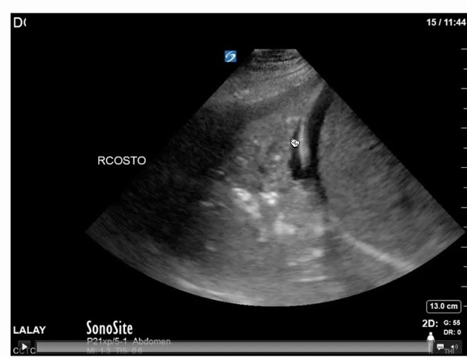
Tissue-like sign
When the lung is highly fluid filled, it resembles the liver in echogenicity— it becomes hepatisized

Slide 23
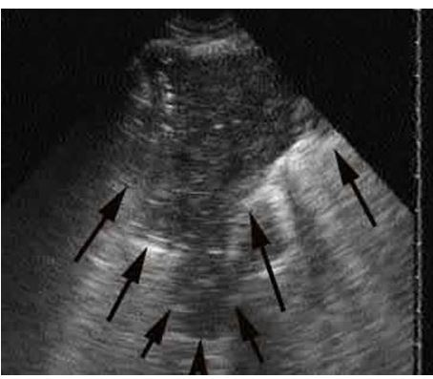
Shred sign
If consolidations are less extensive, and the percentage of air therefore greater, it looks as if chunks have been taken out of the lung (echo poor areas)
These areas will be bordered by aerated lung identified by sliding and comets
The border of consolidated and aerated lung is not sharp
Highly suggestive of pneumonia

Slide 24
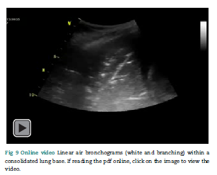
Air and fluid bronchograms
Air bronchograms appear white while fluid bronchograms are black
Fluid bronchograms are specific to pneumonia
They can be distinguished from vessels with colour Doppler and by the angulation of their branches
An air bronchogram which moves with respiration excludes bronchial obstruction and helps distinguish between consolidation and atelectasis

Slide 25
Introduction
Heart failure - leading cause of hospitalization in adults >65 years of age
30 day readmission rate after discharge from a HF hospitalization ≈24%
Readmissions for HF preceded by rise in ventricular filling pressures begins days or weeks before any changes in clinical status.

Slide 26
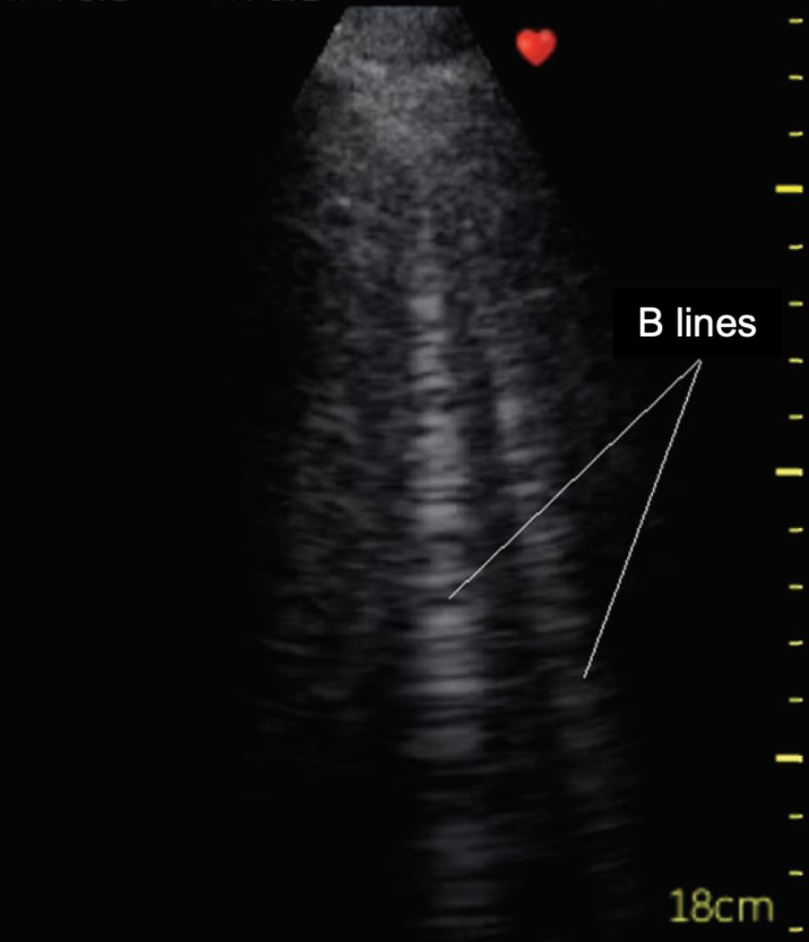
LUS to diagnose interstitial pulmonary edema and fluid overload – detection of vertical reverberation artifacts
B lines created at the acoustic interface between two structures with differing acoustic impedances- fluid filled structures and alveolar air

Slide 27
LUS easily available at bedside
Shows superior sensitivity for the detection of pulmonary congestion when compared with X ray or physical examination even in the absence of symptoms

Slide 28
Pulmonary congestion assessed by LUS identifies:
subgroup with worse prognosis
higher rate of readmission & mortality
Implementation of LUS in the follow up of HF patients may reduce the rate of readmissions is unknown

Slide 29
Objective
To evaluate a protocol of LUS guided therapy to prevent readmissions in HF outpatients

Slide 30
Study design
Single center, single blinded, randomized controlled clinical trial
Conducted from April 1st, 2018 to June 28th, 2019 at Instituto Nacional de Cardiologia, Mexico City, Mexico

Slide 31
Inclusion criteria
Patients admitted to the hospital with the primary or secondary diagnosis of HF
Intra-hospital stay extends for at least 24 hours.
Patient shows new symptoms due to the presentation of HF, including at least one of the following:
dyspnea (dyspnea at rest, at exertion, orthopnea, nocturnal paroxysmal dyspnea),
decreased exercise capacity, fatigue or other symptoms of target organ hypoperfusion or volume overload.

Slide 32
Patient has at least two physical examination findings; or at least one finding to the physical examination and at least one complementary criterion, including:
Physical findings considered to be due to heart failure
peripheral edema,
increase in the abdominal perimeter or ascites in the absence of primary liver disease,
signs of pulmonary congestion including crackles, subcrepitant rales or decrease in vesicular breath sounds,

Slide 33
increase in jugular venous pressure and / or hepatojugular reflux,
gallop by third sound (S3) or clinically significant rapid weight gain, attributed to fluid retention;
and/or complementary findings considered to be due to HF - Increase in levels of NT-proBNP compatible with decompensation of HF(> 2,000 pg / mL), radiographic evidence of pulmonary congestion, or invasive or non-invasive evidence of significant increase in ventricular filling pressures or decreased cardiac output

Slide 34
Exclusion criteria
Non-interpretable lung ultrasound imaging or false positive findings (chronic lung interstitial disease, pneumonia, large pleural effusion).
Lack of willing to provide informed consent
Life expectancy less than 6 months
Chronic kidney injury stage V
Death during index hospitalization
Surgically correctable cause of HF i.e.: severe aortic stenosis or primary mitral regurgitation considered as a candidate for a surgical or percutaneous procedure

Slide 35
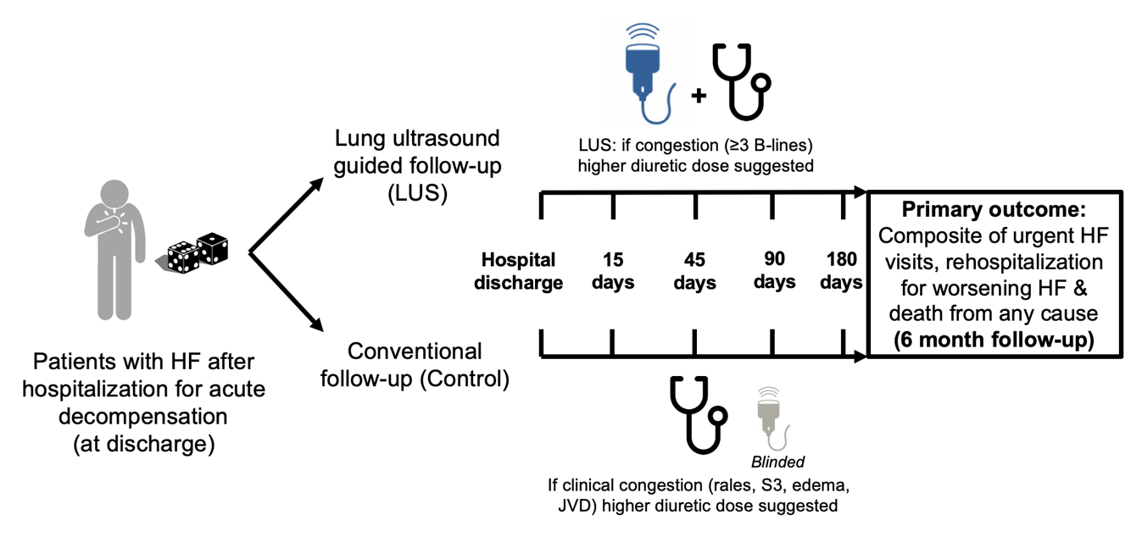
Study design and methods

Slide 36
"LUS-guided therapy group“- prespecified diuretic dose will be administered to patients depending on the degree of US pulmonary congestion:
if congestive (3 or more B lines, in total) a high dose (80-120mg furosemide PO/day) will be prescribed;
if no congestive (less than 3 B lines, in total) a low dose (up to 40mg PO/day) will be prescribed.
Primary outcome will be the composite of hospital readmission + mortality

Slide 37
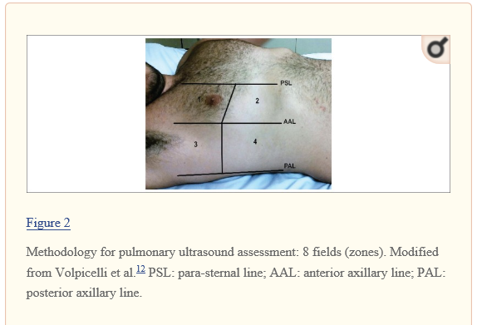
Lung ultrasound studies were performed with a pocket ultrasound device (VScan® Dual Probe; GE Healthcare, Chicago, IL, USA)
LUS recorded in eight thoracic sites (four sites in each hemithorax) with the transducer in sagittal orientation and at 18 cm imaging depth with the patient in the semi-recumbent position.
No. of B-lines reported was the sum of the B-lines visualized in each thoracic site

Slide 38
In case where confluent B-lines were found, visual percentage of lung area occupied by confluent B-lines was used to quantify the number of B-lines (visually occupied area / total scan area (100%) x 0.1)
Presence of pleural effusion was also recorded.
Three-second video clips stored for blinded review

Slide 39
Primary outcome measures
Number of patients with the composite outcome of hospital readmission + mortality + urgent visits for worsening HF [ Time Frame: 6 months ]
Hospital readmission: urgent hospital non scheduled visit and stay of more than 24 hours, requiring medical interventions.
Mortality: patient's death
Urgent visits for worsening HF: non-scheduled visit to day care or ED that prompted increased oral / IV therapy, less than 24 hours stay

Slide 40
Secondary outcome measures
Quality of life measured by Kansas City Cardiomyopathy Questionnaire (KCCQ) [ Time Frame: 6 months ]
NTproBNP concentrations [ Time Frame: 6 months ] NTproBNP concentrations and change by last visit

Slide 41
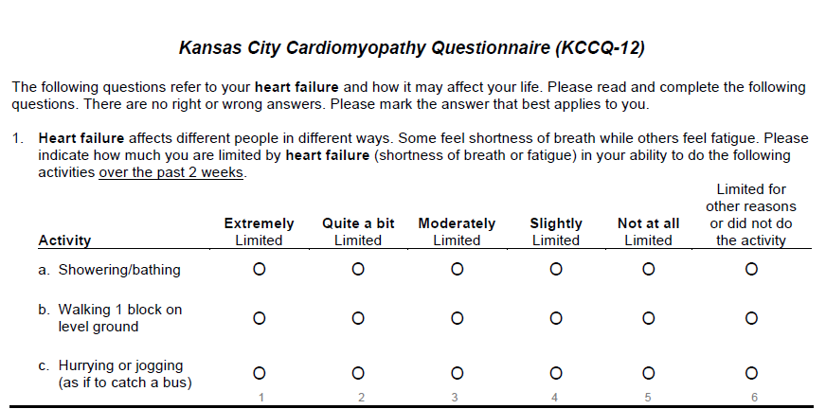

Slide 42
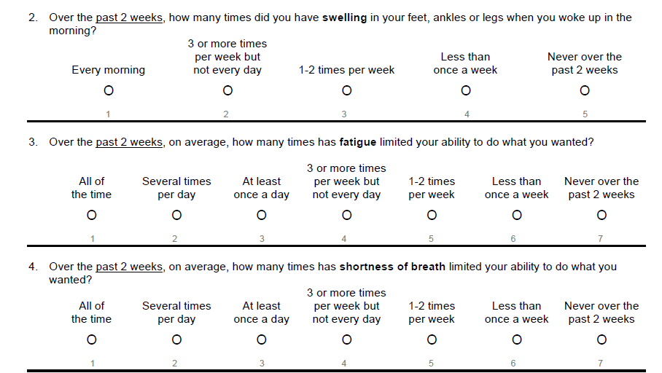

Slide 43
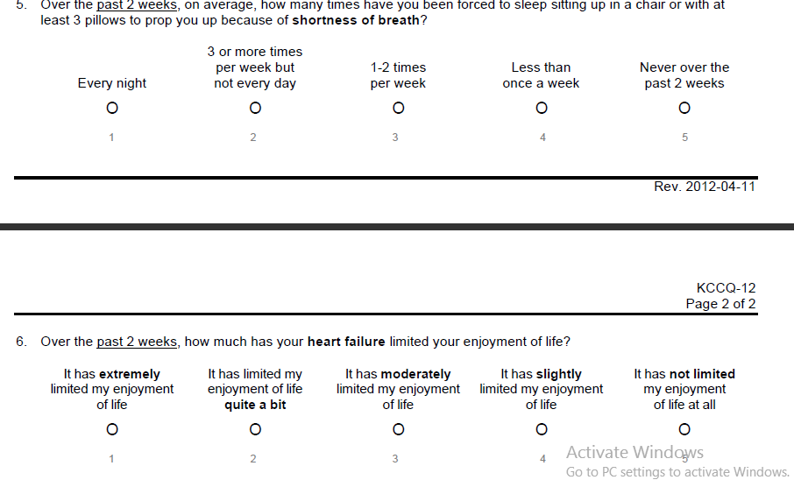

Slide 44
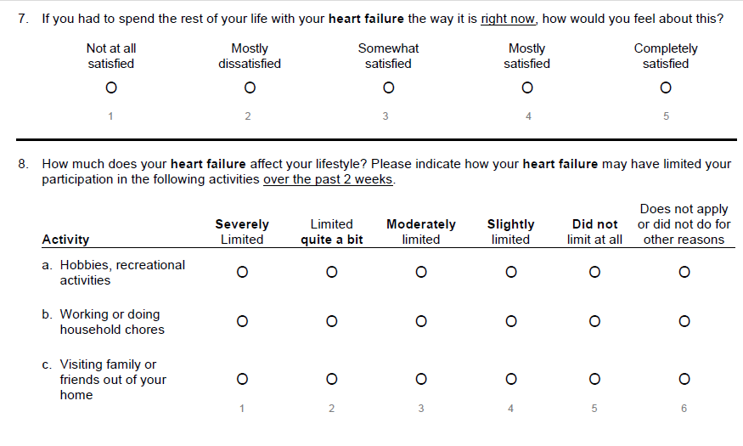

Slide 45
Safety outcomes included :
Diuretic-associated acute kidney injury (defined as a 50% increase in discharge creatinine with a BUN to creatinine ratio >20 and clinical signs of hypovolemia)
hypokalemia (defined as a potassium level of <3.5mmol/L)

Slide 46
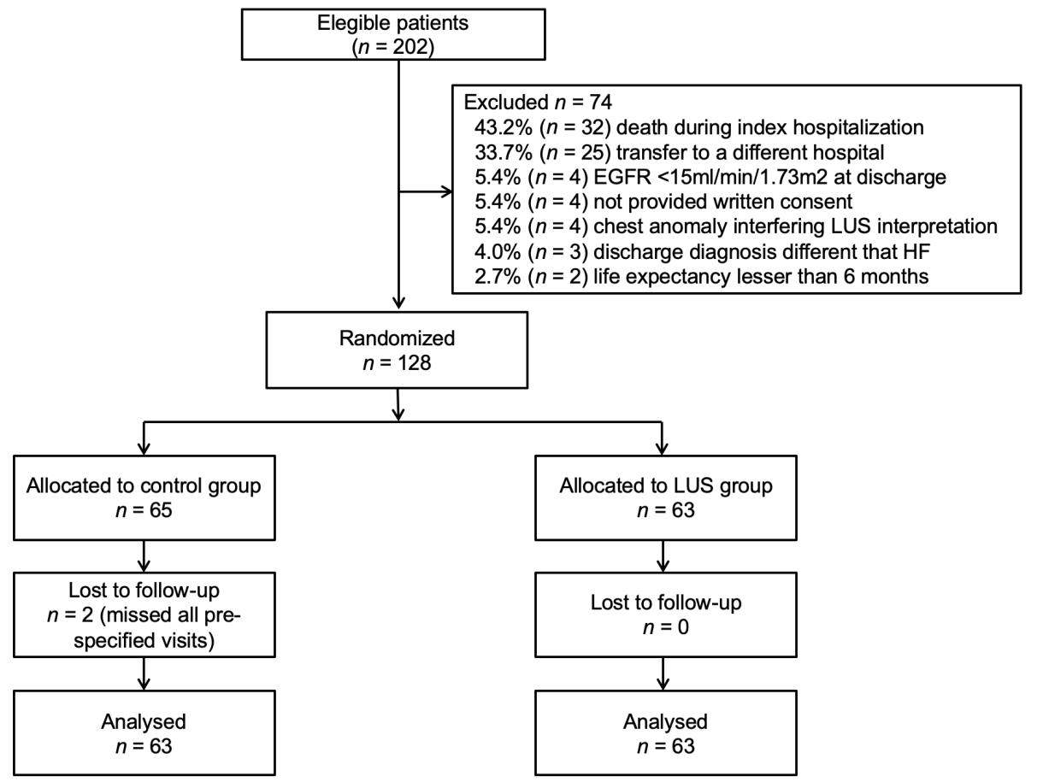
Study flowchart

Slide 47
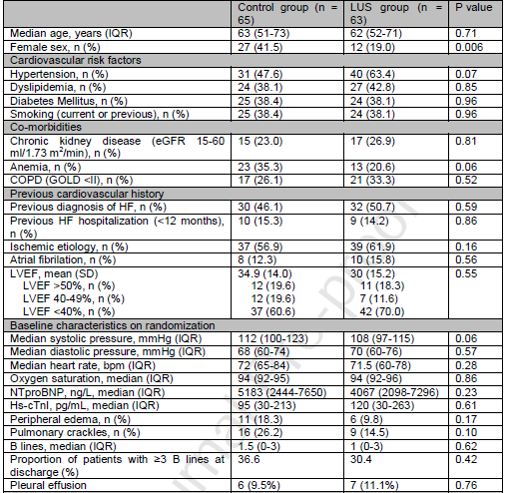
Baseline characteristics

Slide 48
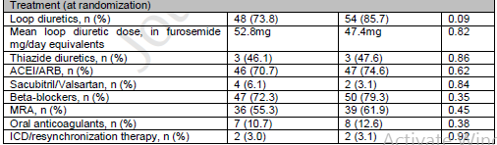

Slide 49
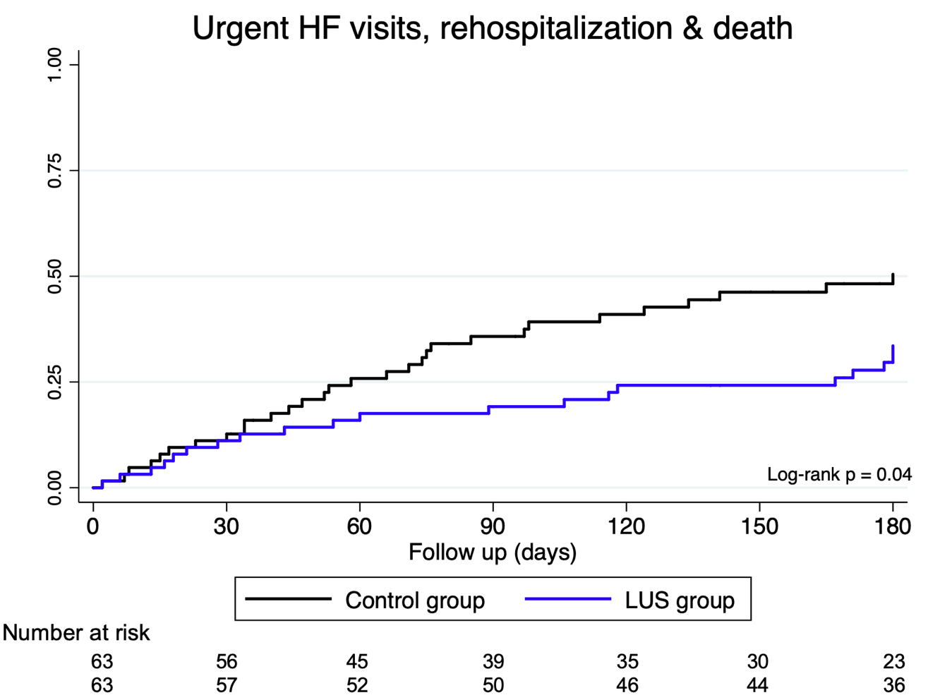
Results
The primary endpoint occurred in 30 (47.6%) patients in the control group and 20 (31.7%) patients from the LUS group (Log-rank P = 0.041)

Slide 50
LUS guided treatment was associated with a 45% risk reduction in the primary endpoint (HR 0.55, 95% CI 0.31 – 0.98, P = 0.044; NNT: 6.3)
Differences in the primary composite endpoint were mainly driven by a reduction in urgent HF visits: 25 (39.6%) patients in the control group and 9 (14.2%) patients in the LUS group (HR 0.28, 95% CI 0.13 – 0.62, P = 0.001; NNT: 3.9)
No statistically significant differences were found in the rates of death or re-hospitalization

Slide 51
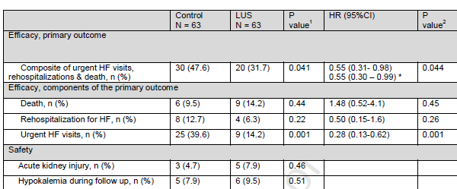
Main efficacy & safety outcomes

Slide 52
NTproBNP showed a 6-month median decrease of 4,010pg/mL
(-76.8%) in the control group and 3,111pg/mL (-76.4%) in the LUS group
(P = 0.87)
A total of 54 patients had their quality of life assessed using KCCQ during the first and last visits (25 in the control group and 29 in the LUS group)

Slide 53
Among them, 11 (44.0%) patients in the control group and 14 (48.2%) patients in the LUS group had a significant (>5.0 points in clinical summary domain) improvement in their quality of life (P = 0.75)
Median change in KCCQ clinical summary at the end of follow up was 3.5 (0.1 - 19.3) in the control group and 6.8 (1.1 – 11.3) in the LUS group (P = 0.95)

Slide 54
Regarding the safety outcomes, no differences were found in the rates of diuretic associated acute kidney injury (control group: 4.7% vs LUS group: 7.9%; P = 0.46) or hypokalemia during follow up (control group: 7.9% vs LUS group: 9.5%; P = 0.51)

Slide 55
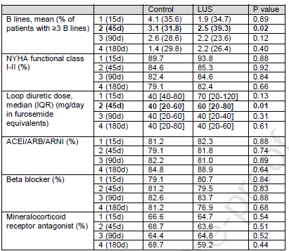
Clinical management according to treatment allocation
The number of urgent visits and re-hospitalizations not attributable to HF was similar in both groups [control group: 11 (17.4%); LUS group: 13 (20.6%), P = 0.86]

Slide 56
Statistically significant differences were observed in the median daily diuretic dose at the 6-week visit: 40 (20-60) mg/d in the control group and 60 (40-80) mg/d in the LUS group (P = 0.01)
The number of patients treated with HF evidence-based medications (ARNI/ARB/ACEi, BB, MRA) were similar in both groups and in every visit.

Slide 57
Discussion
Routine incorporation of LUS was associated with a risk reduction of adverse HF events, mainly urgent HF visits
Allows the detection of “subclinical pulmonary congestion”, a condition associated with increased risk of adverse effects
In this study, ultrasound-guided treatment was associated with improved total decongestion, shorter hospitalizations and improved prognosis.
While this protocol awaits further validation in a randomized trial, it shows promising results for AHF patients.

Slide 58
Study findings are concordant with recently reported by Rivas-Lasarte et al in the LUS-HF study, which randomized 123 patients into either a LUS-guided arm or usual care (control)
Results of this trial showed a risk reduction of 49% (HR 0.51, 95% CI 0.26-0.99, P = 0.049) in the main composite endpoint of all cause death, HF re-hospitalizations and urgent visits for worsening HF in the group of patients allocated to the LUS group

Slide 59
LUS-HF trial
The follow-up consists of visits to the HF clinic at periods of 15 days, 1, 3 and 6 months after the initial hospitalization.
LUS is going to be performed on all patients despite their respective group.
Only in relation to the "LUS group", the treating physician will have the result of the examination and the subsequent treatment adjustment could be made in response to those findings

Slide 60
Similar to CLUSTER-HF study results, the risk reduction in the main composite outcome in LUS-HF was driven by a significant reduction in urgent visits for worsening HF (HR 0.20, 95% CI: 0.06 – 0.73, P = 0.015), while death and HF rehospitalizations showed no significant differences among groups.

Slide 61
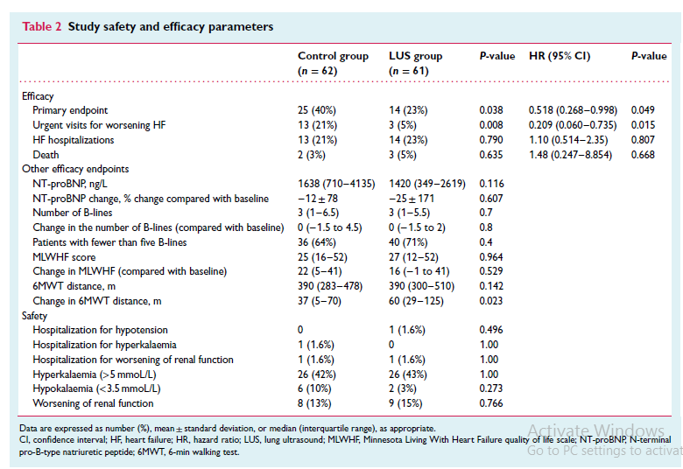

Slide 62
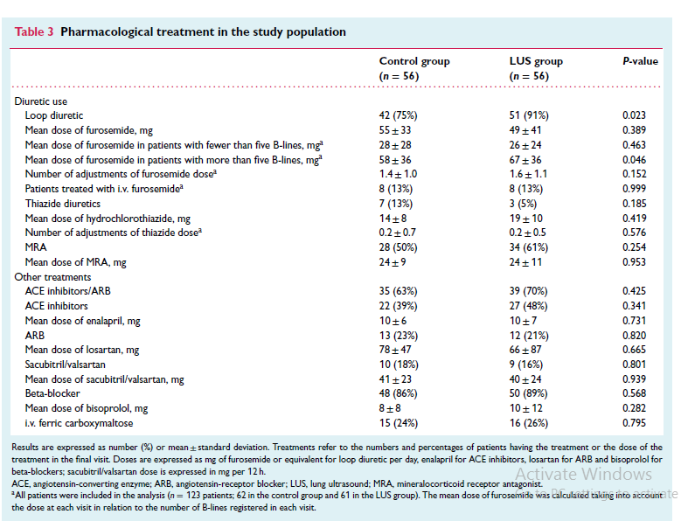

Slide 63
Limitatons
Single-center design may impede the generalizability of the results
Small sample size and the wide confidence intervals of the main composite outcome must be interpreted with care
Study population was markedly ill, showing a high rate of adverse events during follow-up, high levels of NT-proBNP on discharge and a significantly reduced LVEF, which could limit the external validity of these results

Slide 64
Despite that LUS results were blinded for the treating physician in patients allocated in the control arm, it is not possible to exclude the possibility that the investigators performing the LUS examinations may have encouraged the increase in diuretics dosage
Quality of life evaluation using KCCQ was carried out in only 54 patients, which limits the validity of the findings

Slide 65
Conclusion
Routine incorporation of LUS into clinical follow-up of patients with HF is associated with a lower risk of urgent visits for worsening HF
LUS is a risk free, inexpensive and readily accessible tool that allows the detection of subclinical pulmonary congestion and may avoid adverse HF events

Slide 66
Thank you!

